Slide 1
Handwriting Analysis using Graphology
Team Members Tag: SECURITY
Project Advisor: Ms. P. Malathi
(Assistant Professor – CSE)
S.No | Reg.No | Name of the Student | Section
1 | CB.EN.U4CSE19012 | B. SAI GAYATHRI REDDY | CSE A
2 | CB.EN.U4CSE19015 | E. SAHITYA | CSE A
3 | CB.EN.U4CSE19019 | G.L.SRESHTA | CSE A
4 | CB.EN.U4CSE19623 | J.SAI RUPA | CSE F

Slide 2
PROPOSED METHODOLOGY
1). Text Image Acquisition
2). Pre processing
a). Resizing
b). Color Conversion
3). ROI Segmentation using Improved Morphology
4). Classification using Deep Learning
5). Get Fingerprint Image
6). Repeated line tracking for Feature extraction
7). Check Authentication
8). If authenticated result will be displayed otherwise denied

Slide 3
WORK DONE
1). Text Image Acquisition
2). Pre processing
a). Resizing
b). Color Conversion
3). ROI Segmentation using Improved Morphology

Slide 4
WORK LEFT TO DO
Classification using Deep Learning
Classification using Googlenet -CNN
i)Convolution layer
ii)reluLayer
iii)Pooling Layer
iv)fullyConnectedLayer
v)dropoutLayer
2. Get Fingerprint Image
3. Repeated line tracking for Feature extraction
4. Check Authentication
5. If authenticated result will be displayed otherwise denied

Slide 5
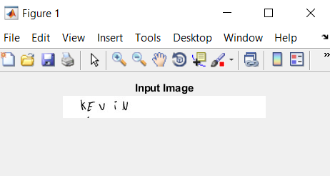
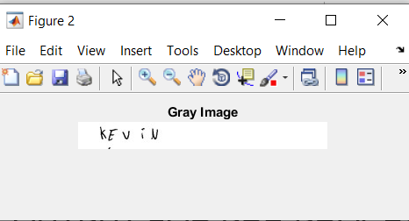
OUTPUT FOR PRE-PROCESSING AND ROI SEGMENTATION

Slide 6
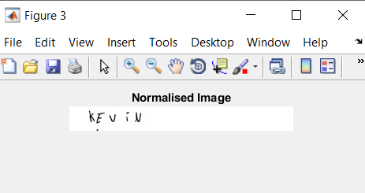
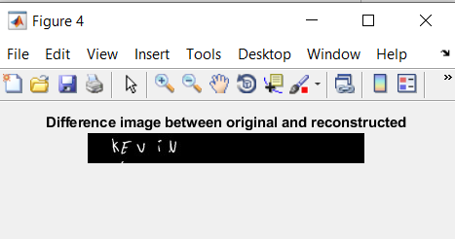
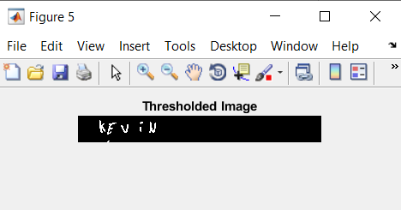
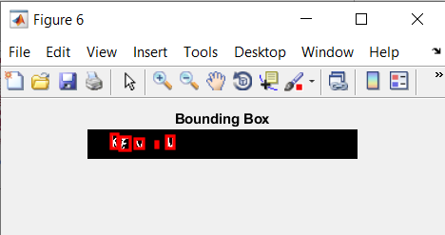

Slide 7
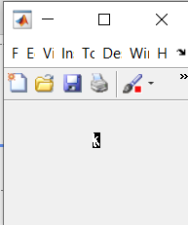
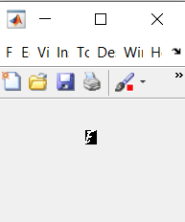
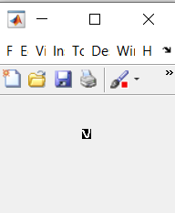
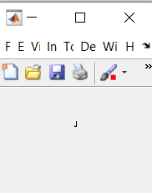
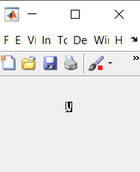

Slide 8
THANK YOU

